Slide 1
A
Presentation On
Presentation Skills
BY
Prashant Madhukar Bankar

Slide 2
Introduction
Presentation is a talk giving information about a subject, a product or an idea.
Important form of oral communication.
Well researched, prepared and rehearsed point of view.
Lecture, Demonstration, Group Discussion etc.

Slide 3
Planning Presentation.
Decide the topic.
Collection of the relevant information.
Presentation plan- Objectives and purpose only main points.
Prepare necessary diagram, collect images and pictures, statistical information.
Prepare the script of your presentation.
Selection of the audio-visual aids.( Slides, projectors, flipchart, black or white board, film or real object)
Structuring your presentation.
Preparation for handling question answer session.

Slide 4
How to make PowerPoint impressive?
Keep it simple.
Use visual images as much as possible.
Never put more words; avoid description and narration.
Make your titles headlines.
Placed images properly.
On each slides have maximum five bullet points

Slide 5
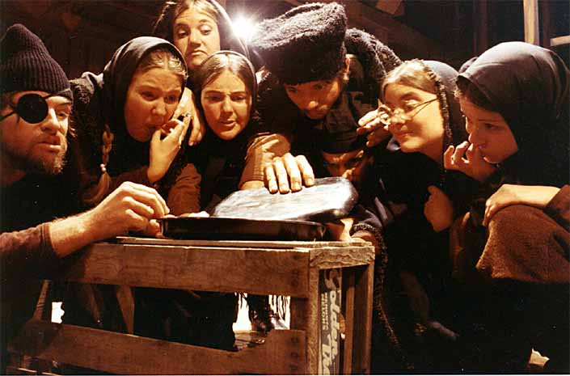
Image placed on the slide
Do not waste one slide to present image.
Don’t use any picture or image as watermark to slide.
Use only relevant and supportive images.
E.g. image on this slide is related to epic theatre.

Slide 6
Language of Presentation
Pronunciation must be perfect.
Voice modulation must be correct.
Simple language.
Politeness in the speech.
Supportive body language.

Slide 7
Tips for Presentation
Give new and fresh idea.
Clarity of the topic.
Do not imitate.
Practice is very essential.
Collect the information about the audience before the presentation.
Do not read from the slides.
Don’t black the screen.
Give the audience handout of your presentation at the end of presentation.
Be habitual with the use of machine that you are using for presentation.

Slide 8
Don’t talk to fast.
Use light color slide background.
Use formal attire.

Slide 9
Preparation for presentation
Read different types of books.
Watch English news channels.
Participate in various competitions.
Learn from websites.
Read newspapers and magazines.
Practice.

Slide 10
Thank You

